Slide 1

Capstone Project
Email Campaign Effectivness Prediction
Team Members
Shubham Deshmukh

Slide 2

Content
Introduction
Data Summary
Analysis of Data
Null value Imputation/ Data Cleaning
Data Preprocessing
Handelling Imbalnced Data
Model Training
Evaluation Metrics
Challenges
Conclusion

Slide 3
Introduction:
Most of the small to medium business owners are making effective use of Gmail-based Email marketing Strategies for offline targeting of converting their prospective customers into leads so that they stay with them in Business.
The objective of this project is to provide marketers who are regularly authoring email marketing campaigns with a thorough understanding of what we’re doing, so they
too can leverage the machine learning models to characterize the mail and track the
mail that is ignored; read; acknowledged by the reader.

Slide 4
Data Summary:
The dataset comprised of 12 features including the target variable Email_Status.
Email_ID — This column contains the email ids of individuals.
Email_type — Email type contains 2 categories 1 and 2. We can assume that the types are like promotional email or important email.
Subject_Hotness_Score — It is the email effectiveness score.
Email_Source — It represents the source of the email like sales or marketing or product type email.
Email_Campaign_Type — Campaign type
Total_Past_Communications — This column contains the previous mails from the same source.
Customer_Location — Categorical data which explains the different demographics of the customers.
Time_Email_sent_Category — It has 3 categories 1,2 and 3 which may give us morning,evening and night time slots.
Word_Count — It contains the no.of words contained in the mail.
Total_Links — Total links from the mail.
Total_Images — The banner images from the promotional email.
Email_Status — It is the target variable which contains the characterization of the mail that is ignored; read; acknowledged by the reader.
The total no. of records in our dataset is 68353.

Slide 5
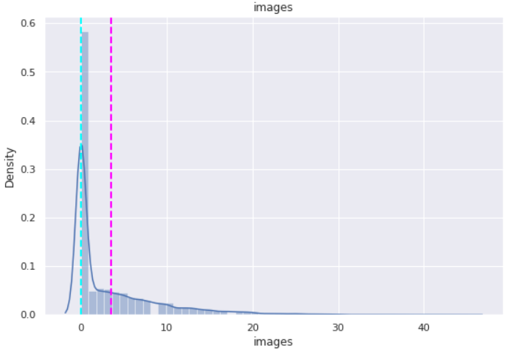
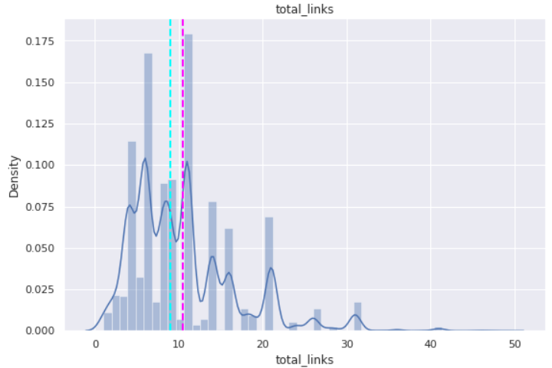
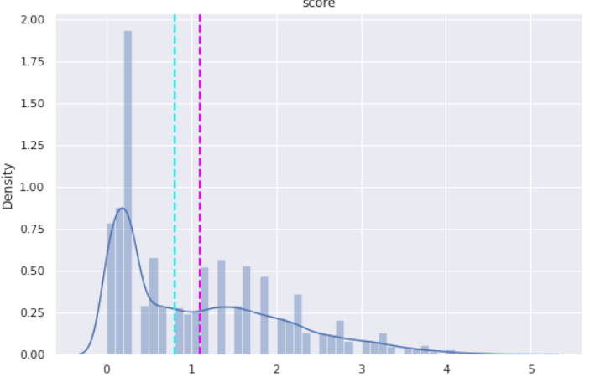
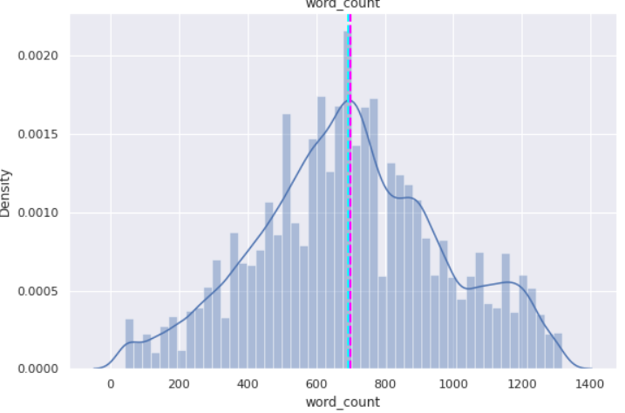
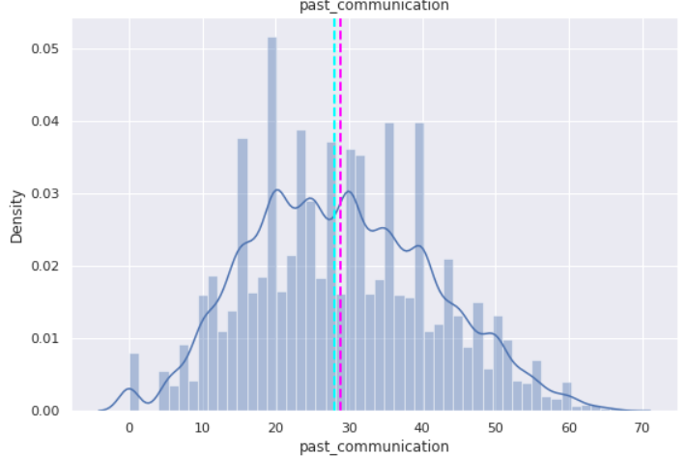
Univariate Analysis

Slide 6
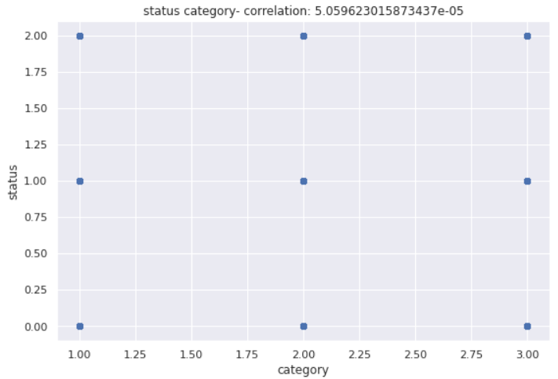
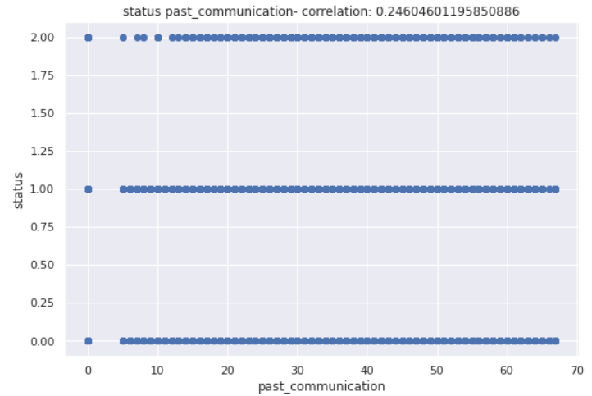
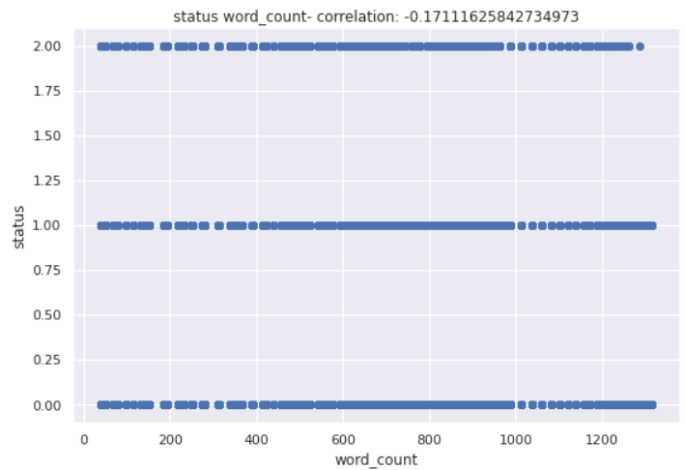
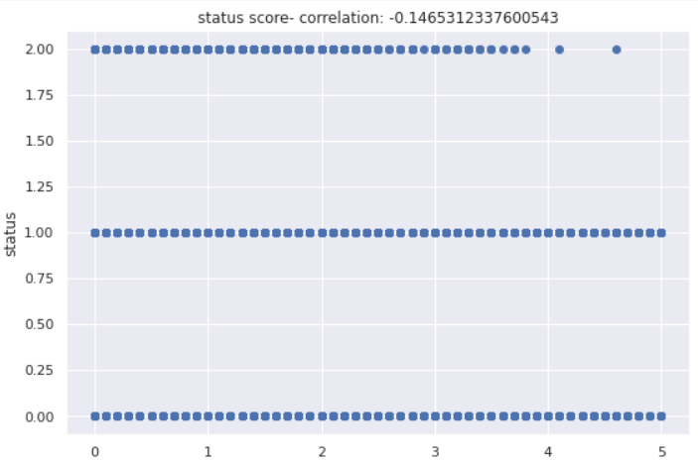
Bivariate Analysis

Slide 7
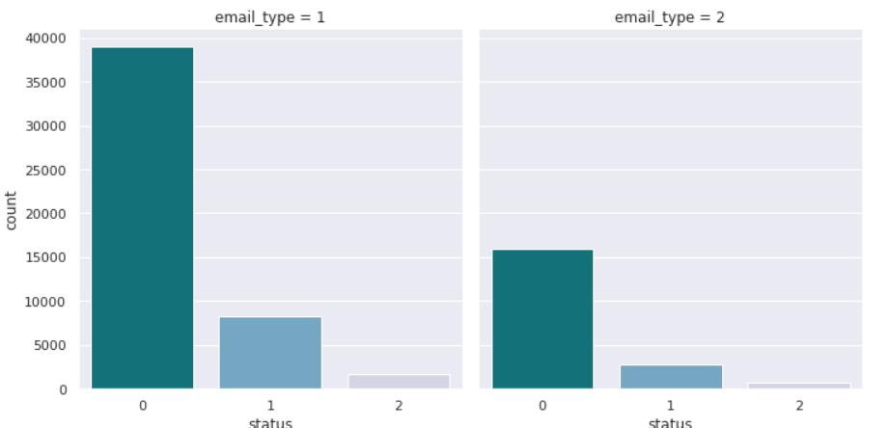
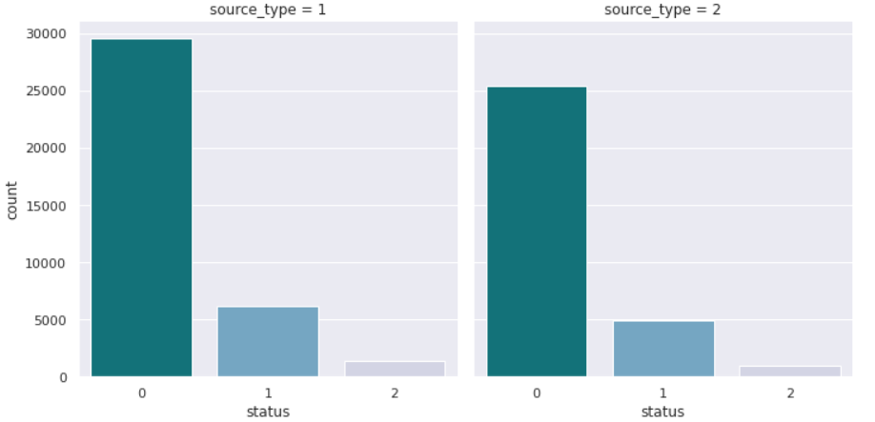
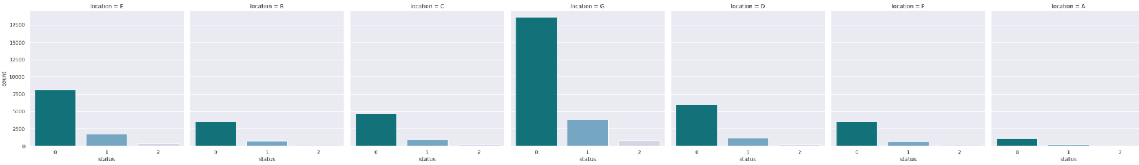
Analysis variables:

Slide 8
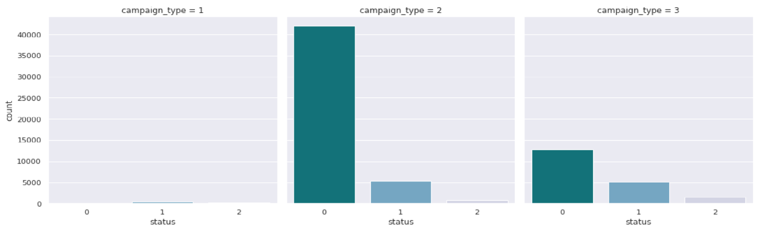
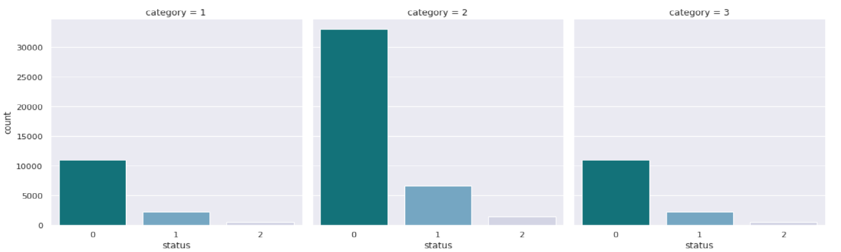
Cont..

Slide 9
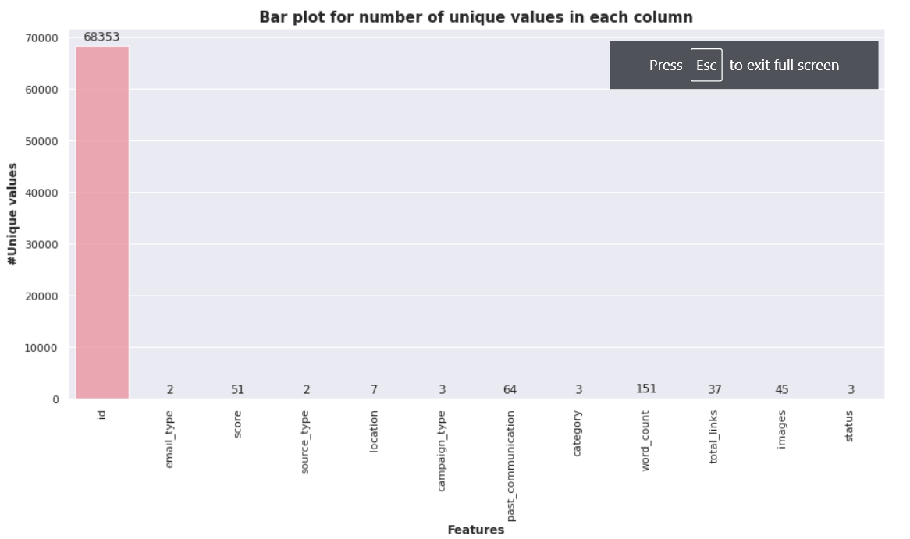
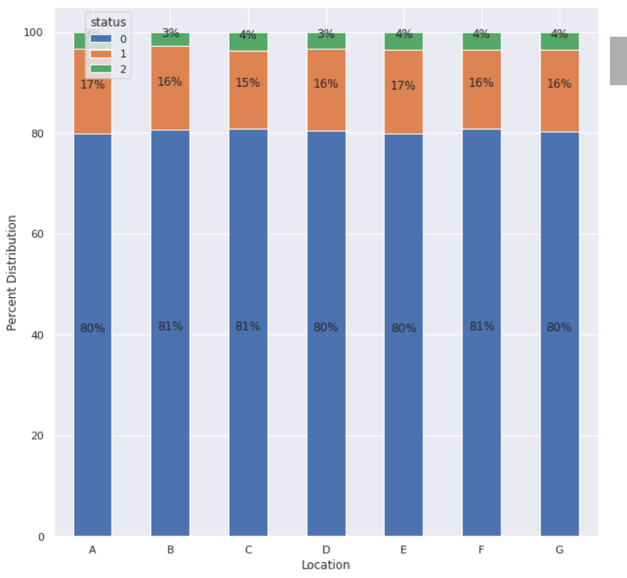
Cont..

Slide 10
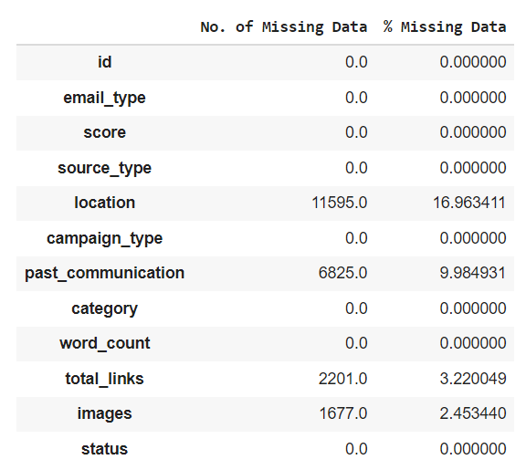
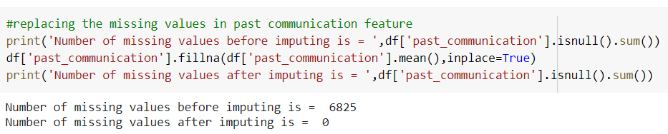
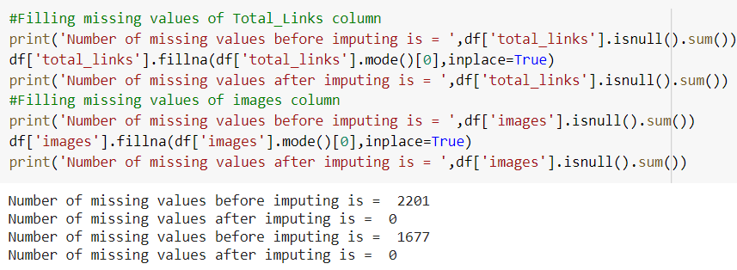
Dealing with missing Values

Slide 11
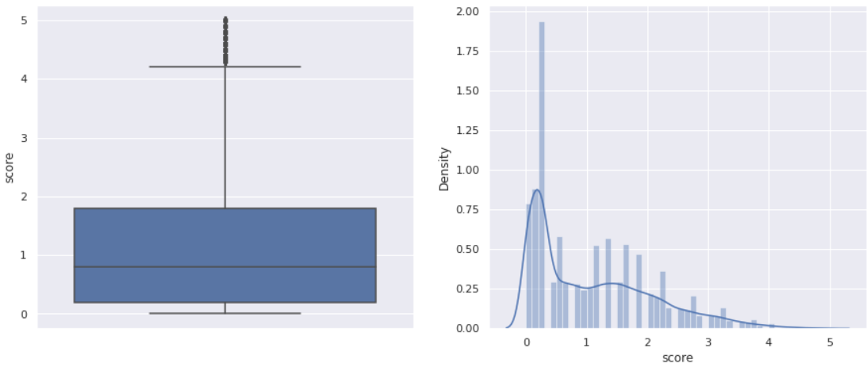
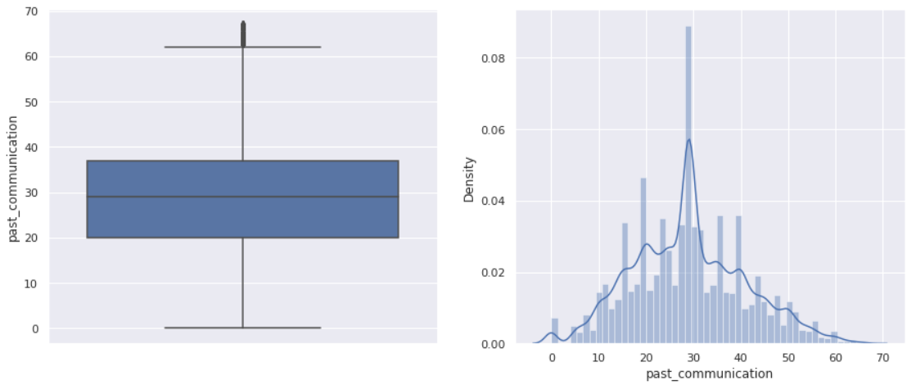
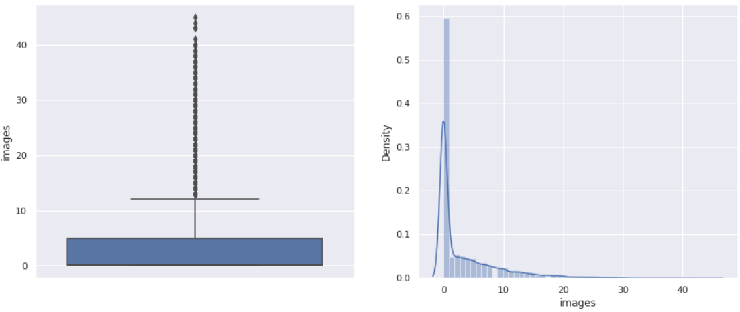
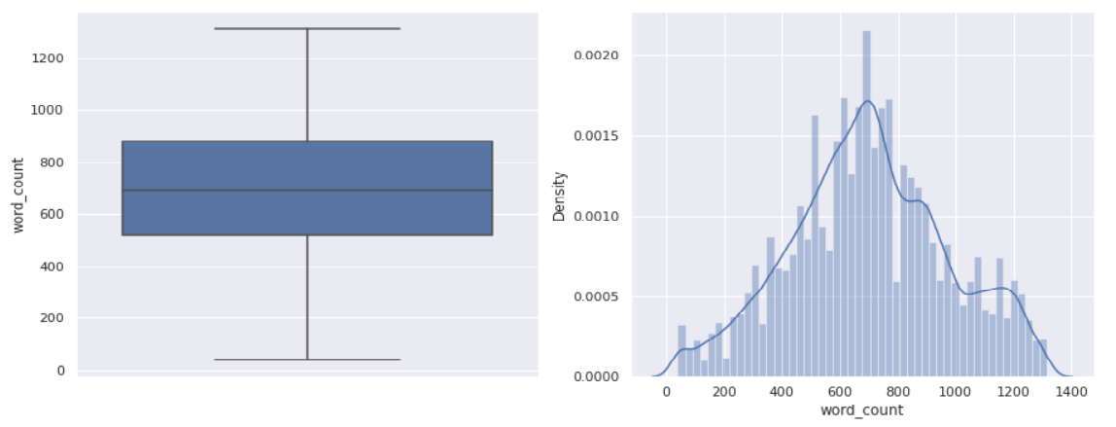
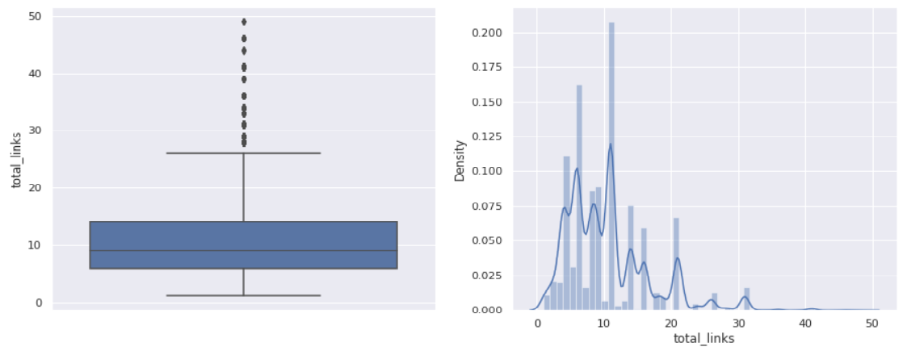
Outliers

Slide 12
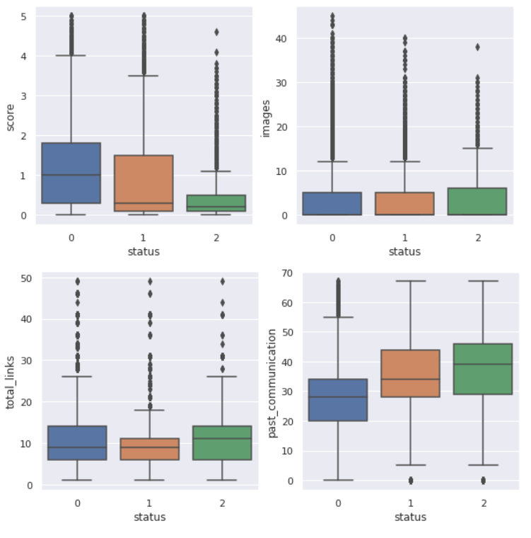
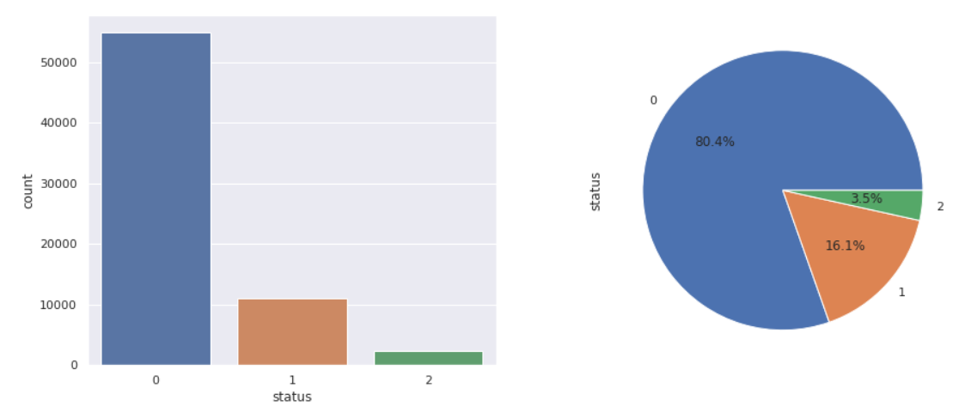
Cont..

Slide 13
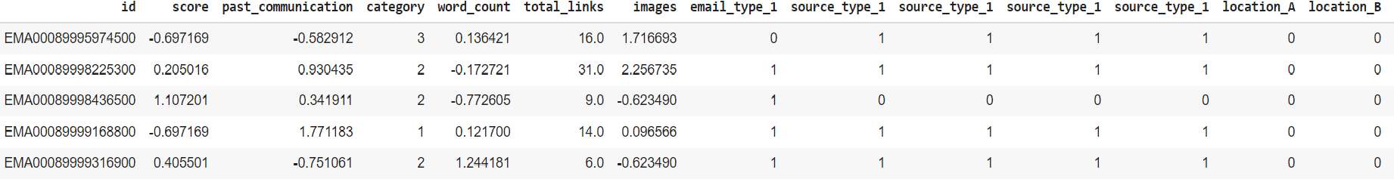
Categorical Encoding and Standardization

Slide 14
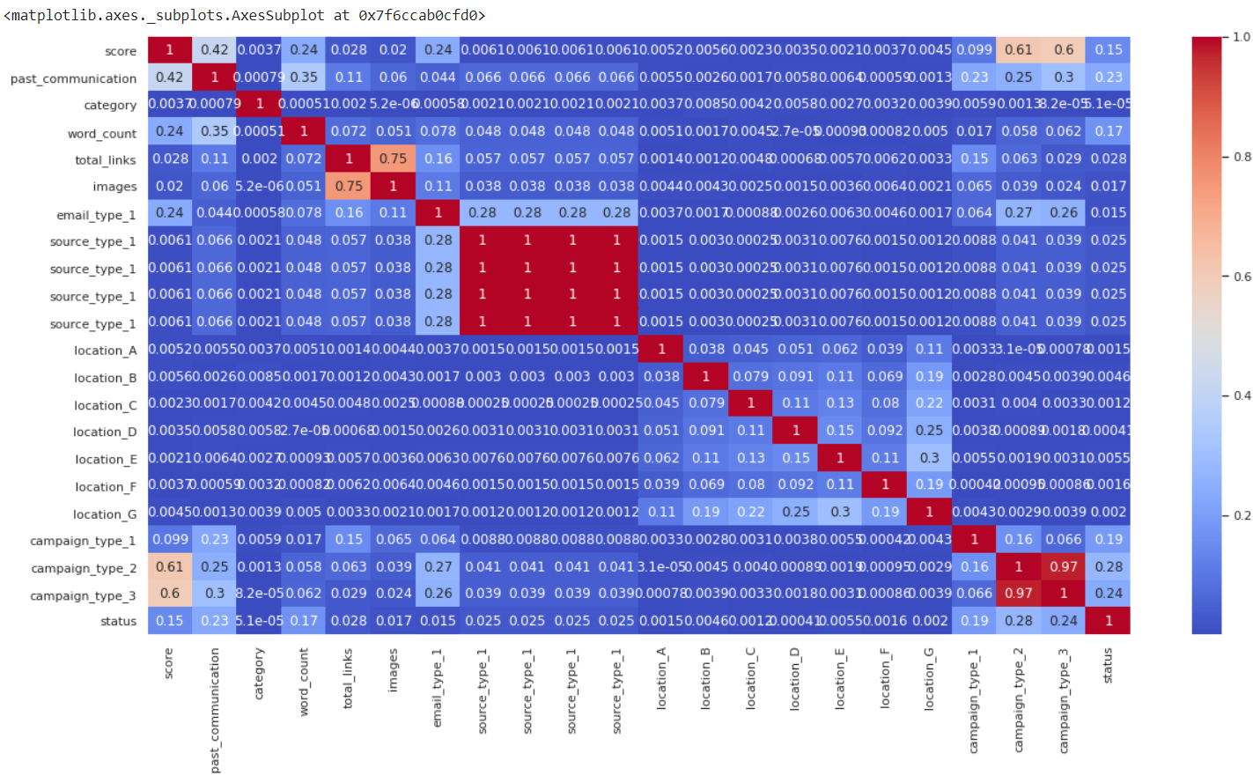
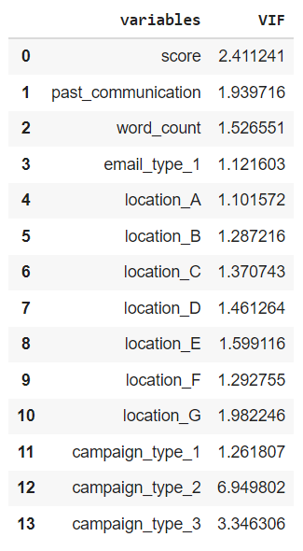
Correlation between the variables:

Slide 15
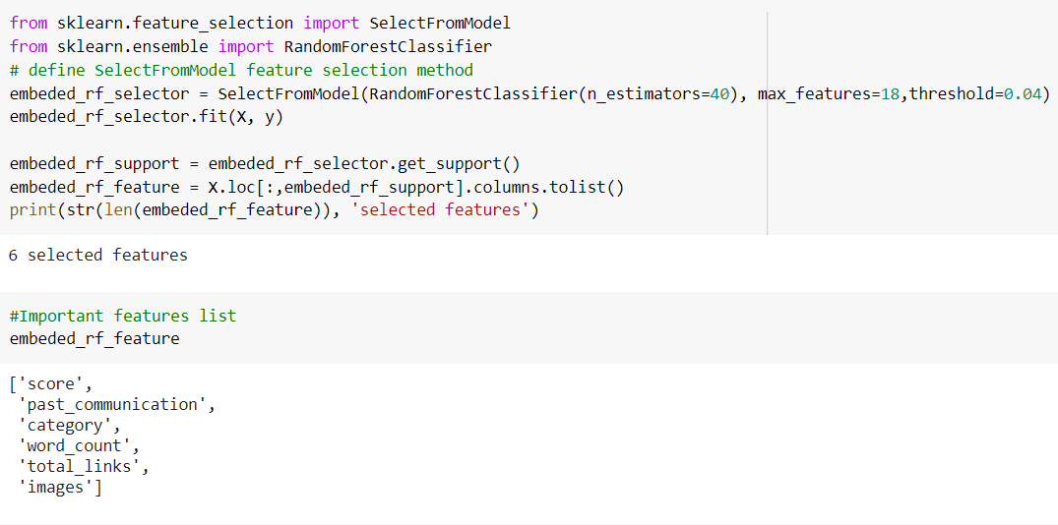
Feature Selection

Slide 16
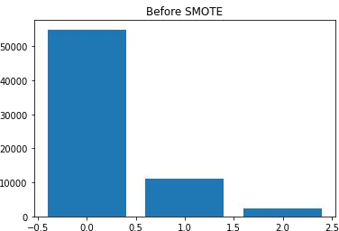
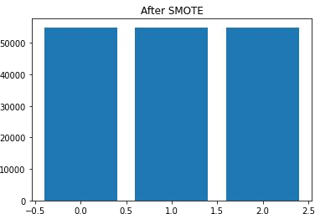
Handelling Imbalanced Data
Synthetic Minority Oversampling Technique (SMOTE)
This technique generates synthetic data for the minority class.
SMOTE (Synthetic Minority Oversampling Technique) works by randomly picking a point from the minority class and computing the k-nearest neighbors for this point. The synthetic points are added between the chosen point and its neighbors.
Created balanced data with 54941 records for each class.

Slide 17
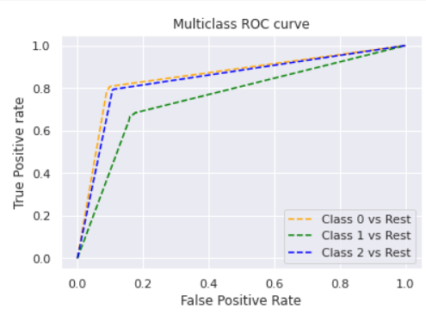
Decision Tree Classifier –
A decision tree is a graphical representation of all possible solutions to a decision based on certain conditions. On each step or node of a decision tree, used for classification, we try to form a condition on the features to separate all the labels or classes contained in the dataset to the fullest purity.
F1_Score- Train Set: 0.99, Test_Set:0.76

Slide 18
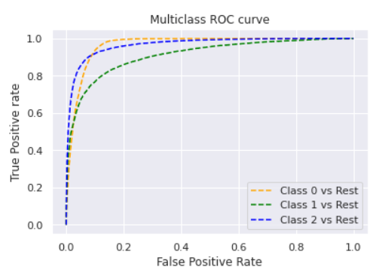
XGBoost Model
XGBoost or extreme gradient boosting is one of the well-known gradient boosting techniques (ensemble) having enhanced performance and speed in tree-based (sequential decision trees) machine learning algorithms.
Parameters used - (n_estimators=100, max_depth=25, min_samples_leaf=20, min_samples_split=30)
F1_Score- Train Set: 0.98, Test_Set:0.84

Slide 19
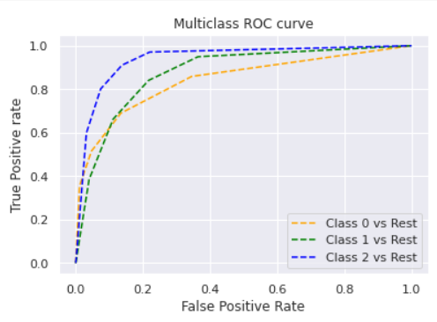
KNN Model
The k-nearest neighbors (KNN) algorithm is a simple, supervised machine learning algorithm that can be used to solve both classification and regression problems. It's easy to implement and understand, but has a major drawback of becoming significantly slows as the size of that data in use grows.
Parameters Used - (n_neighbors = 4, metric = 'minkowski', p = 2)
F1_Score- Train_Set:0.85, Test_Set:0.75

Slide 20
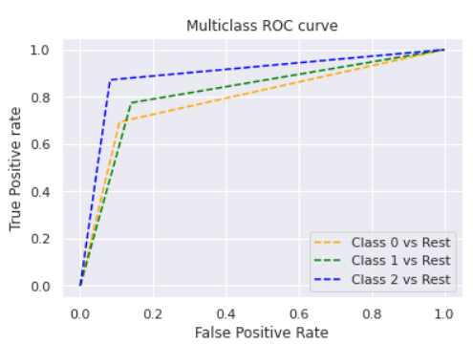
RandomsearchCV KNN
Random search is a technique where random combinations of the hyper parameters are used to find the best solution for the built model. It is similar to grid search, and yet it has proven to yield better results comparatively.
Parameters used –‘n_neighbors':np.arange (1, 5)
F1_Score- Train_Set:0.98, Test_Set:0.78

Slide 21
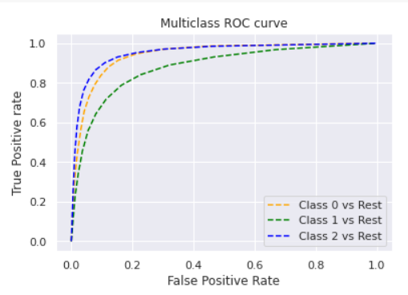
Random Forest
Random forest is a supervised learning algorithm. The "forest" it builds, is an ensemble of decision trees, usually trained with the “bagging” method. The general idea of the bagging method is that a combination of learning models increases the overall result.
Parameters Used - (n_estimators = 12, criterion = 'entropy', random_state = 42)
F1_Score- Train_Set:0.98, Test_Set:0.81

Slide 22
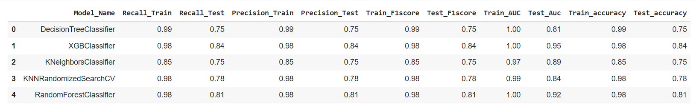
Modelling

Slide 23
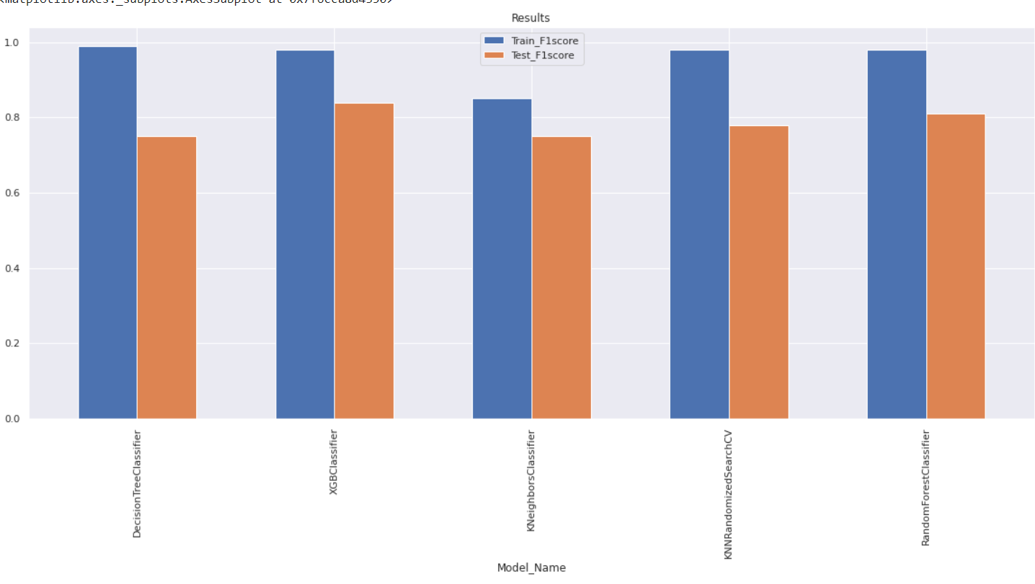
Evaluation of Models
F1 - Score

Slide 24
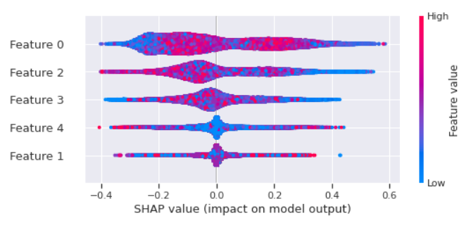
SHAP
SHAP (SHapley Additive exPlanations) is a game theoretic approach to explain the output of any machine learning model. It connects optimal credit allocation with local explanations using the classic Shapley values from game theory and their related extensions (see papers for details and citations).
The plot shows global summary of the distribution of SHAP values over all features. For each feature (horizontal rows), you can see the distribution of feature importances. From the diagram we can see that score and category have large effects on the prediction over the entire dataset (high SHAP value shown on bottom axis). High category values affect the prediction negatively (red values on the left hand side), while score category values affect the prediction positively (red values on the right hand side), similarly in the opposite direction for both variables
In Our case
Feature 0 - Score
Feature 1- Past communication
Feature 2- Category
Feature 3- Word Count
Feature 4- images

Slide 25
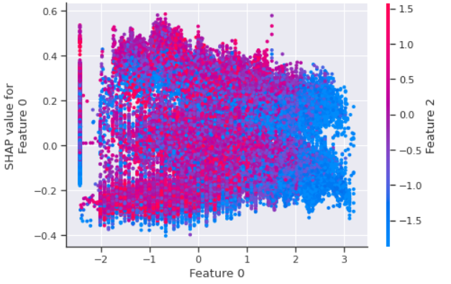
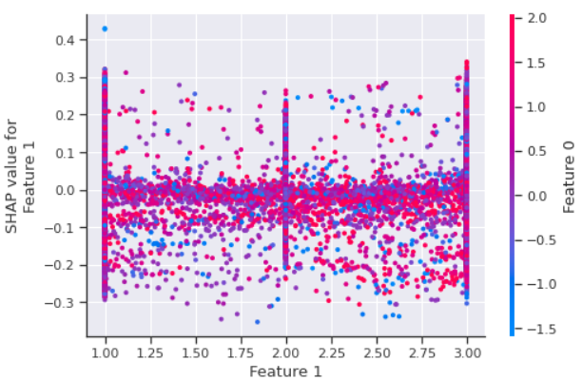
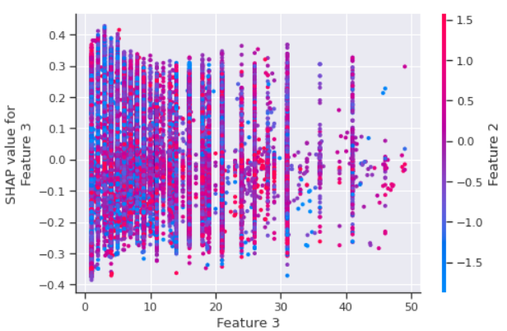
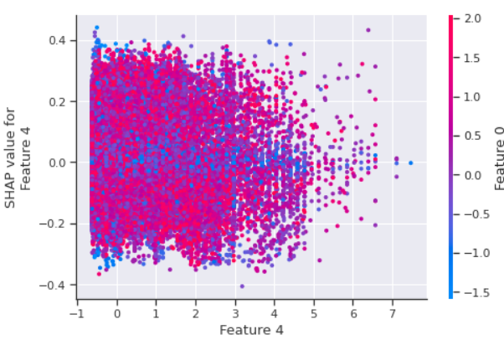
Interpretation Plots
1)The 1 st graph - (Score vs Category)
The high score and low value of category
decreases the probabilty of target class.
2)The 2 nd graph - (Score vs Past communication)
The low score and high past communication
Decreased the probabilty of target class.
3)The 3 rd graph - (Category vs Word count)
The low word count and high category value increased the probabilty of target class
4)The 4 th graph - (Total links vs score)
Low value of links and high score increased the probabilty of target class.

Slide 26
Challenges
Overﬁtting was another major challenge during the modelling process.
Decision making on missing value imputations and outlier treatment was quite challenging as well.
Interpreting the SHAP model was challenging.

Slide 27
Conclusion
In EDA, we observed that the category 2 , email-type 1 & campaign type-2 was high in number.Univariate analysis and bivariate analysis gave us features information distrubution.
It was observed that both Time_Email_Sent and Customer_Location were insignificant in determining the Email_status. The ratio of the Email_Status was same irrespective of the demographic or the time frame the emails were sent on.
We have imbalanced data the status with value 0 comparises 80% of data.So to deal with it we used SMOTE method.
Based on the metrics, XG Boost Classifier worked the best giving a train score of 98% and test score of 84% for F1 score.
From SHAP we observed that the score and Category are important features.

Slide 28
Thank You!

